Slide 1
Use Case Diagrams | Unified Modeling Language (UML)
Md Rajib Mia
Lecture (Senior Scale) SWE, DIU

Slide 2
Use Case Diagram
A Use Case Diagram is a vital tool in system design, it provides a visual representation of how users interact with a system.
It serves as a blueprint for understanding the functional requirements of a system from a user’s perspective, aiding in the communication between stakeholders and guiding the development process.

Slide 3
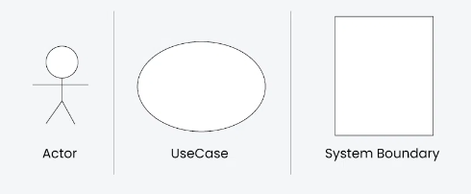
Use Case Diagram Notations

Slide 4
Use Case Diagram Relationships
Association Relationship
Include Relationship
Extend Relationship
Generalization Relationship

Slide 5
Association Relationship
The Association Relationship represents a communication or interaction between an actor and a use case.
It is depicted by a line connecting the actor to the use case.
This relationship signifies that the actor is involved in the functionality described by the use case

Slide 6

Include Relationship
The Include Relationship indicates that a use case includes the functionality of another use case.
It is denoted by a dashed arrow pointing from the including use case to the included use case. This relationship promotes modular and reusable design.

Slide 7

Extend Relationship
The Extend Relationship illustrates that a use case can be extended by another use case under specific conditions. It is represented by a dashed arrow with the keyword “extend.” This relationship is useful for handling optional or exceptional behavior.

Slide 8
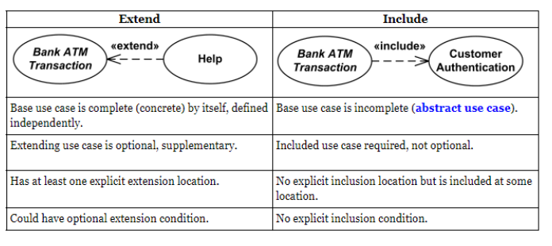
Include vs Extend

Slide 9
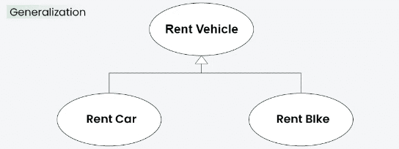
Generalization Relationship
The Generalization Relationship establishes an “is-a” connection between two use cases, indicating that one use case is a specialized version of another.
It is represented by an arrow pointing from the specialized use case to the general use case.

Slide 10
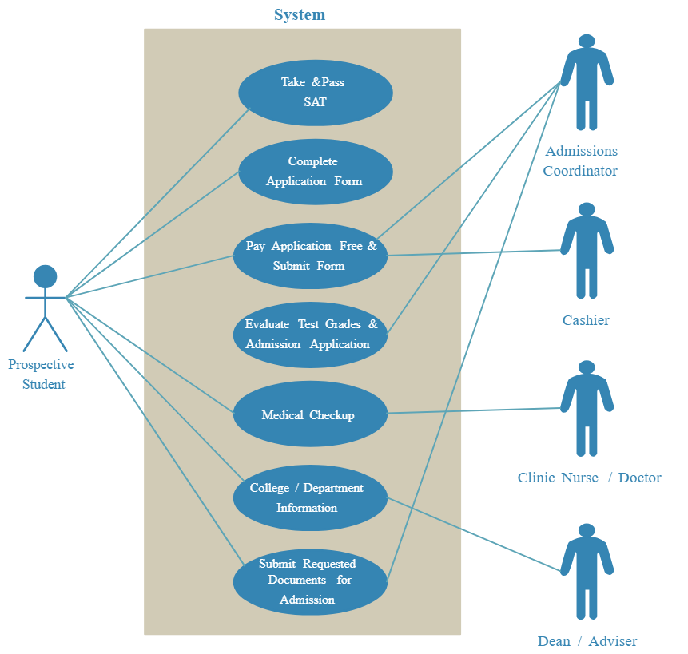

Slide 11
<<include>>
Login
User Athentication
Check Payment Status
Check Clearance
Assign Course
Teacher
Secondary Actor
Check Live Result
Student
Primary Actor
Check SGPA
Help Desk
Provide Feedback
<<exclude>>

